Slide 1
Lecture#10: GPIO Part#2 (Chapter#14) Summer, 2025
Embedded Systems with ARM Cortex-M Microcontrollers in Assembly Language and C
CSE331: Microprocessor Interfacing and Embedded Systems
Credit: Dr. Mohammad A. Qayum

Slide 2
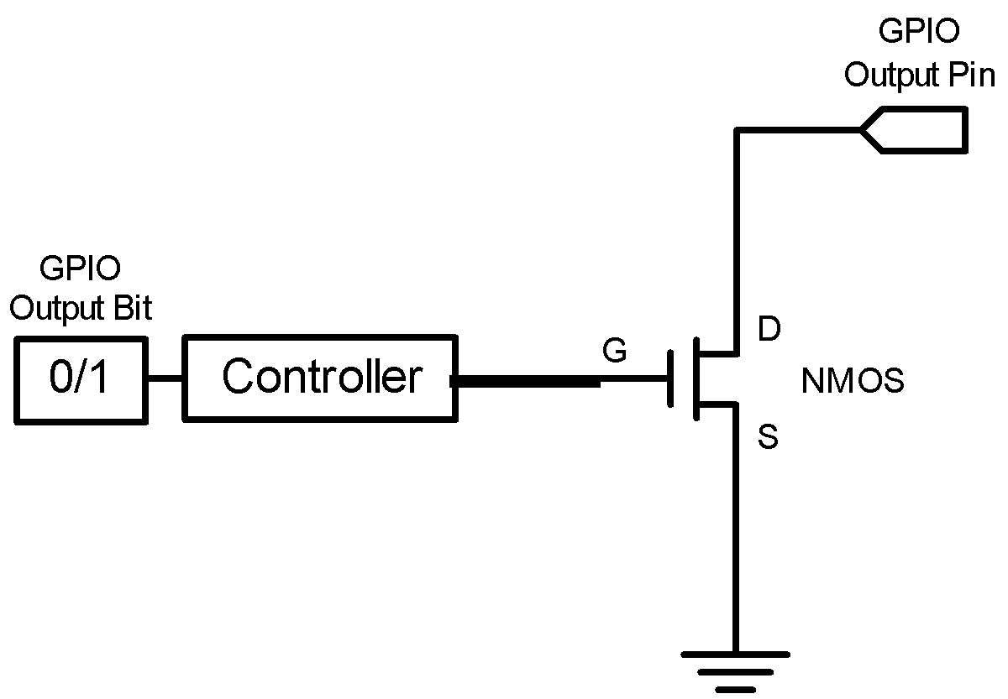
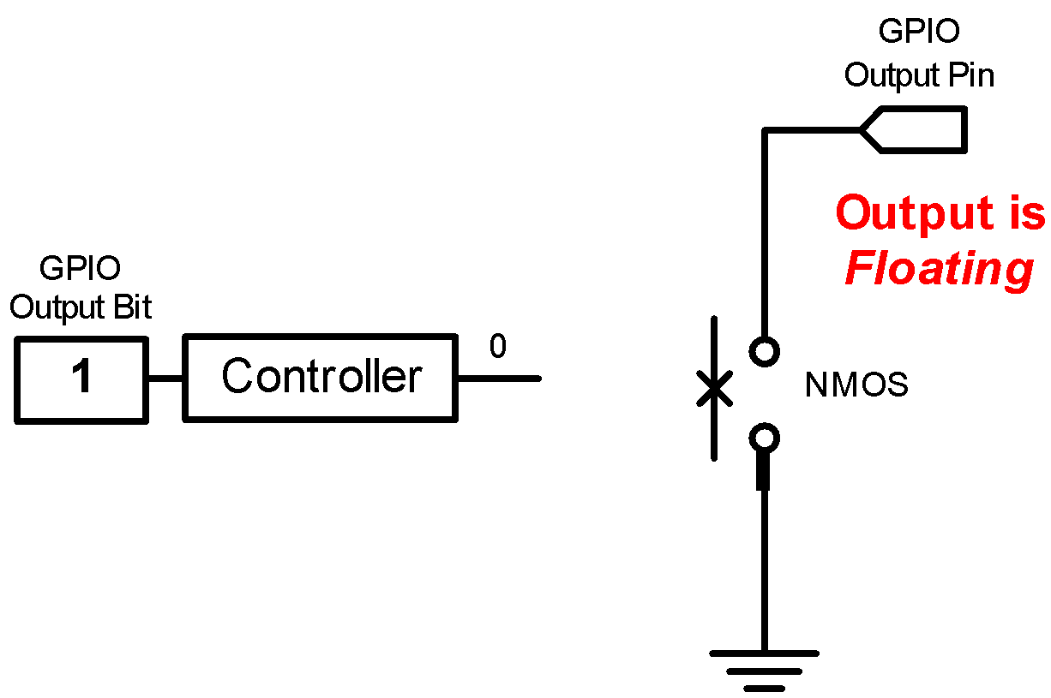
GPIO Output: Open-Drain
Output = 1
GPIO Pin has high-impedance to external circuit

Slide 3
GPIO Output Speed
Output Speed:
Speed of rising and falling
Four speeds: Low, Medium, Fast, High
Tradeoff
Higher GPIO speed increases EMI noise and power consumption
Configure based on peripheral speed
Low speed for toggling LEDs
High speed for SPI
Speed of Rising
Low
Medium
Fast
High

Slide 4
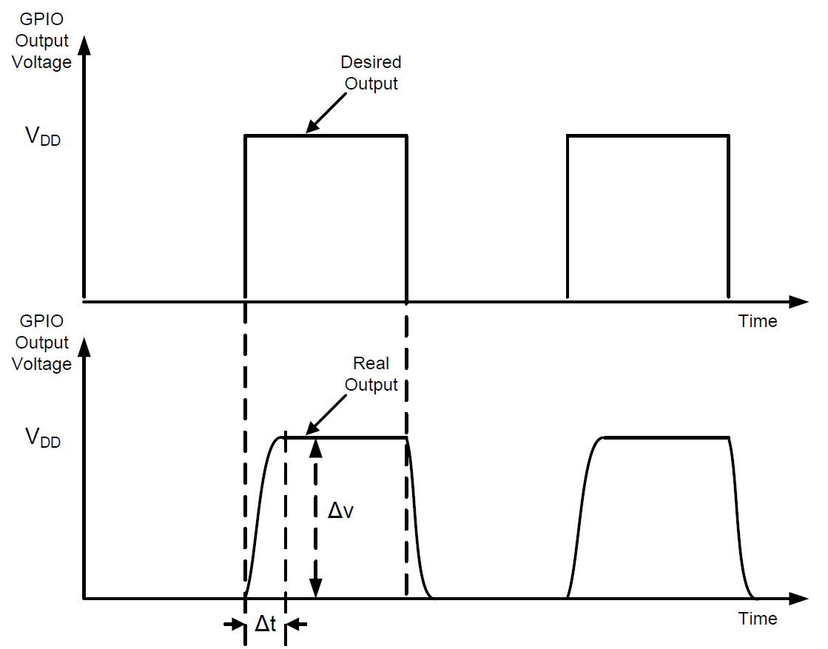
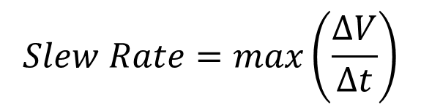
Slew Rate
Slew Rate:
Maximum rate of change of the output voltage
A high slew rate allows the output to be toggled at a fast speed.

Slide 5
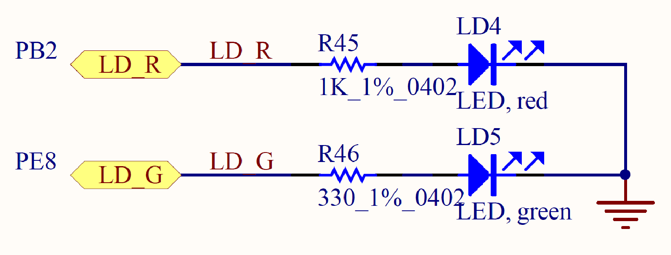
GPIO Output: Push-Pull vs Open-Drain
Output Bit | Push-Pull | Open-Drain
1 | High | HiZ
0 | Low | Low
Use push-pull output, instead of open-drain output!
Notes:
{{Pause=2}} This table summarizes the difference between push pull, and open drain. Their difference is that, in the push-pull output, when the output data bit is one, the output pin has a high voltage. However, in the open-drain output, when the output data bit is one, the output pin is floating, or has high impedance. {{Pause=1}} In this example, we need to provide a high voltage on the output pin, in order to turn on the LED. Therefore, we have select the push-pull output, instead of the open-drain output.

Slide 6
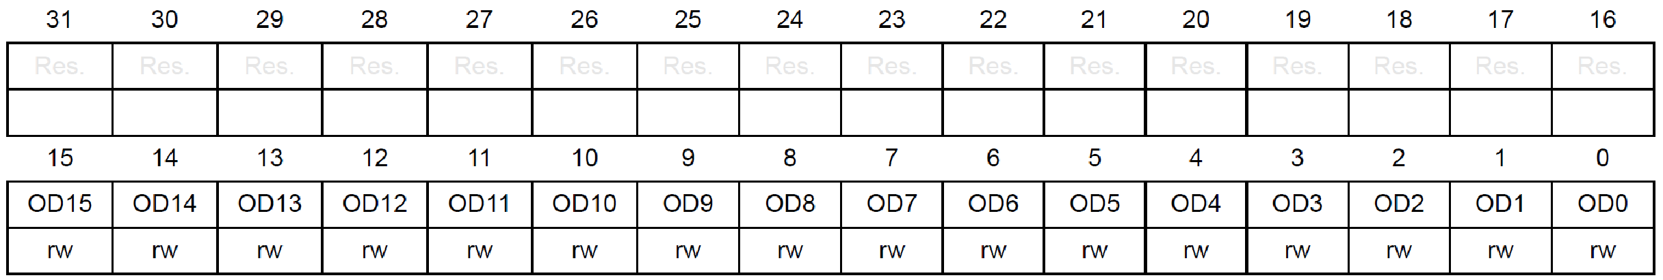
GPIO Output Data Register (ODR)
16 bits reserved, 16 data bits, 1 bit for each pin
Pin 2
GPIOB->ODR |= 1UL << 2; // Set bit 2
Notes:
{{Pause=2}} The output data register is easy to understand. This register has the upper 16 bits reserved. It has 16 data bits, with one bit for each pin. Because the red LED is connected to pin 2, to turn on the LED, we need to set, bit 2, of the output data register, to 1.

Slide 7
Light up the Red LED (PB.2)
RCC->AHB2ENR |= RCC_AHB2ENR_GPIOBEN; // Enable clock of Port B
GPIOB->MODER &= ~(3UL<<4); // Clear mode bits
GPIOB->MODER |= 1UL<<4; // Set mode to output
GPIOB->OTYPE &= ~(1UL<<2); // Select push-pull output
GPIOB->ODR |= 1UL << 2; // Output 1 to turn on red LED
Notes:
{{Pause=2}} This slide summarizes the software code, which can turn on the red LED. The red LED is connected to pin 2 of port B. The software involves four steps. First, we turn on the clock to enable port B. Then, we set the mode of pin 2 of port B as digital output. Next, we select push-pull output, instead of open-drain output. Finally, we set, bit 2, of the output data register to light up the red LED.

Slide 8
GPIO Initialization
Turn on the clock to the GPIO Port (e.g. Port B)
RCC->AHBENR |= RCC_AHBENR_GPIOBEN; Reset and Clock Control (RCC)
Configure GPIO mode, output type, speed, pull-up/pull-down
typedef struct
{
__IO uint32_t MODER;
__IO uint16_t OTYPER;
uint16_t RESERVED0;
__IO uint32_t OSPEEDR;
__IO uint32_t PUPDR;
__IO uint16_t IDR;
uint16_t RESERVED1;
__IO uint16_t ODR;
uint16_t RESERVED2;
__IO uint16_t BSRRL; /* BSRR register is split to 2 * 16-bit fields BSRRL */
__IO uint16_t BSRRH; /* BSRR register is split to 2 * 16-bit fields BSRRH */
__IO uint32_t LCKR;
__IO uint32_t AFR[2];
} GPIO_TypeDef;
#define PERIPH_BASE ((uint32_t)0x40000000)
#define AHBPERIPH_BASE (PERIPH_BASE + 0x20000)
#define GPIOB_BASE (AHBPERIPH_BASE + 0x0400)
#define GPIOB ((GPIO_TypeDef *) GPIOB_BASE)

Slide 9
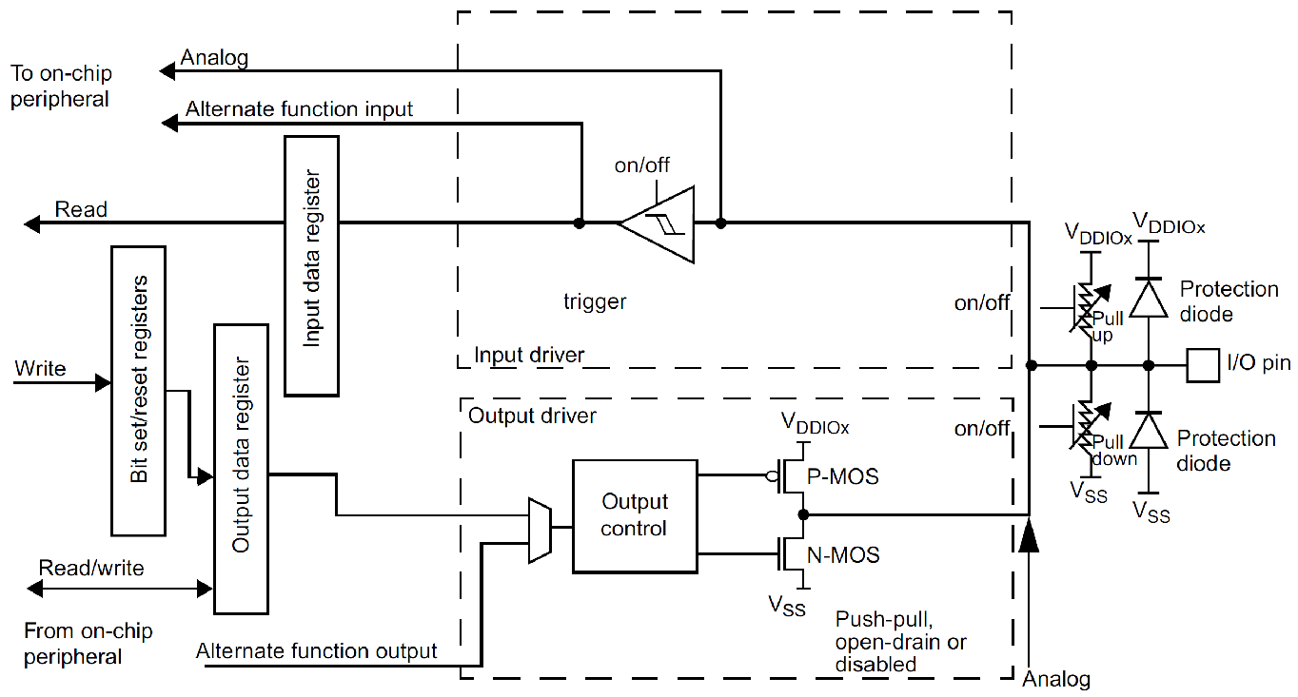
Basic Structure of an I/O Port Bit Input and Output
Schmitt
trigger
Notes:
{{Pause=2}} Most G P I O ports have 16 pins. This diagram shows the standard structure of one G P I O pin. It includes the basic structure for both digital input, and digital output. In this lecture, I will only focus on the digital output part. We will discuss the digital input in a separate lecture.

Slide 10
Basic Structure of an I/O Port Bit: Output
GPIO Pull-up/Pull-down Register (PUPDR)
00 = No pull-up, pull-down 01 = Pull-up
10 = Pull-down 11 = Reserved
Output Data Register
Schmitt
trigger
GPIO Output Type Register (OTYPER)
0 = Output push-pull (default)
1 = Output open-drain
GPIO MODE Register
00 = Input, 01 = Output,
10 = AF, 11 = Analog (default)
Notes:
{{Pause=2}} Here is the basic structure, that is designed for digital output, on one G P I O pin. There are four important registers related to output, including the output data register, {{Pause=1}} the mode register, {{Pause=1}} the data output type register, {{Pause=1}} and the pull-up pull-down register. In this slide, I only give a short overview of each registers. Detailed discussion will be presented in the next few slides. {{Pause=1}} We can use the mode register to configure the pin as output. {{Pause=1}} The output type register, sets the output pin as, either push-pull or open-drain. {{Pause=1}} The pull-up pull down register, specifies, whether the pin is pulled up to a high voltage by a resister, or the pin is pulled down to the ground via another resister.
{{Pause=1}} When the pin is configured as output, the value written to the output data register is output on the G P I O pin. {{Pause=1}} However, whether the pin has a high voltage output, a low voltage output, or a high impedance output, depends on the configuration of the output type register, and the pull-up pull-down register.

Slide 11
Basic Structure of an I/O Port Bit: Input
Schmitt
trigger
Reduce noise
Increase slew rate
Input Data Register (IDR)
GPIO Pull-up/Pull-down Register (PUPDR)
00 = No pull-up, pull-down 01 = Pull-up
10 = Pull-down 11 = Reserved
Notes:
{{Pause=2}} Except the G P I O mode register, there are two other registers, which are related to G P I O input. They are the input data register (IDR), and the pull-up pull-down register (P U P D R).
{{Pause=1}} The input module, includes one important electronic component, called, Schmitt Trigger. The Schmitt trigger circuit is a special voltage comparator. It has two functions. First, it reduces noises, and provides a cleaner and more reliable signal. Second, it converts a slow signal edge, into a clean edge with instantaneous transition. Thus, it can increase the slew rate of signals.

Slide 12
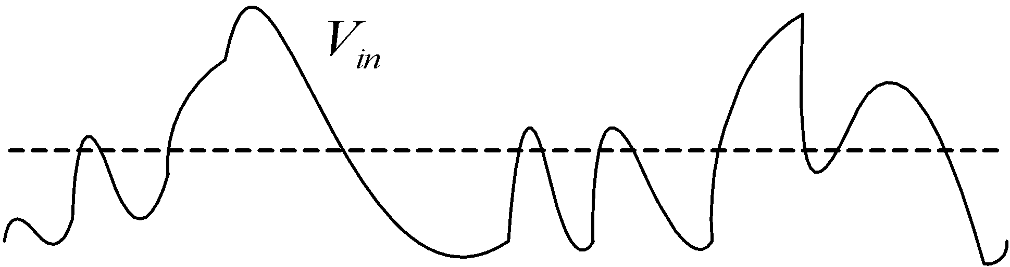
Schmitt Trigger
Threshold
Analog signals
Noisy
Rise and fall slowly (small slew rate)
Notes:
{{Pause=2}} Let me explain the motivations of the Schmitt trigger. In practice, an analog signal often has electronic noise, introduced by various electronic components. The noise makes the signal fluctuate frequently. In addition, analog signal tends to rise or fall slowly, because of inherent parasitic capacitance, resistance, or induction in electronic circuits. Accordingly, analog signals tend to have small slew rates. The slew rate describes how fast a voltage changes. It is usually measured in volts per microsecond.

Slide 13
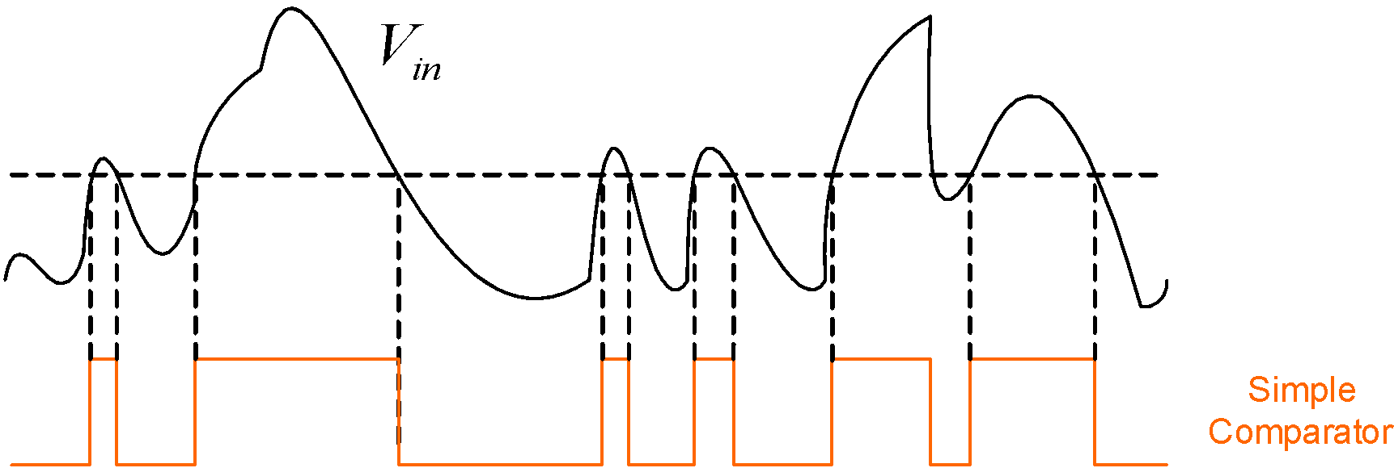
Schmitt Trigger
Threshold
Notes:
Let’s see what will happen, if we use a simple comparator, to convert the analog input signal, to a binary digital signal. The simple comparator compares the input voltage with a pre-defined threshold. If the input is larger than the threshold, then the comparator outputs high level. Otherwise, the comparator outputs low level. Here is the output of the simple comparator.

Slide 14
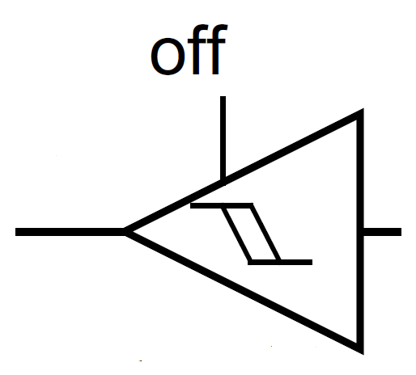
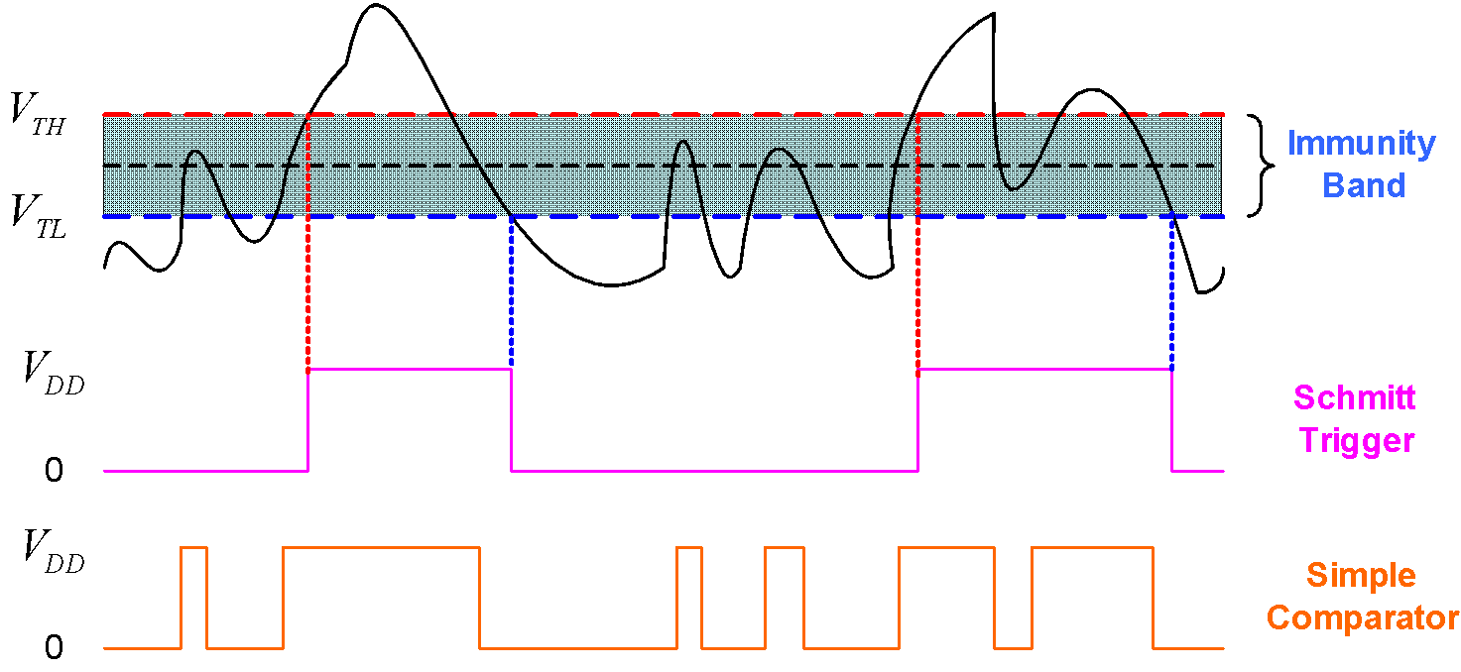
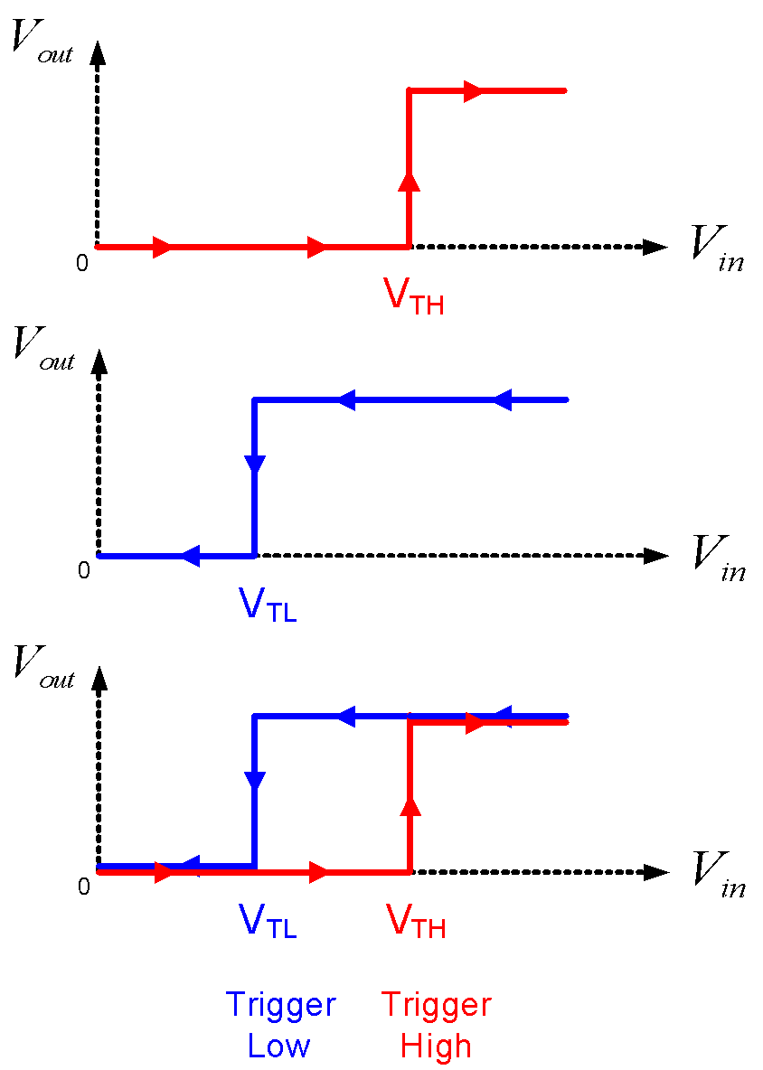
Schmitt Trigger
V_{out}
V_{in}
Notes:
{{Pause=2}} Different from the simple comparator, the Schmitt Trigger is a special circuit, which switches the output, based on two different thresholds. They are called the trigger high threshold, and the trigger low threshold. The output of a Schmitt Trigger depends on the current input, and the history of the input. When the input voltage increases from zero, the output remains low, until the input becomes larger than the high threshold. {{Pause=1}} Similarly, when the voltage decreases gradually, the output remains high, until the input becomes smaller than the low threshold. {{Pause=1}} Any fluctuation in the range between the high and low thresholds is ignored by the Schmitt trigger.
{{Pause=2}} This figure compares the output of the Schmitt Trigger, and the simple comparator. When the input signal fluctuates slightly, the output of the Schmitt Trigger does not switch its output level. For example, at the beginning, the output of Schmitt Trigger is low. When the input signal fluctuates, the output remains low as long as the input signal is lower than the high threshold. Similarly, if the current output is high, even thought the input fluctuates, the output remains high as long as the input is higher than the low threshold.
{{Pause=1}} From this simple example, we can see that, the Schmitt Trigger switches its output, much less frequently than the simple comparator. Accordingly, the Schmitt trigger helps eliminate noise in the input signal.

Slide 15
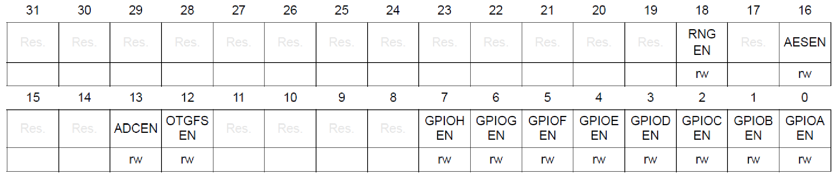
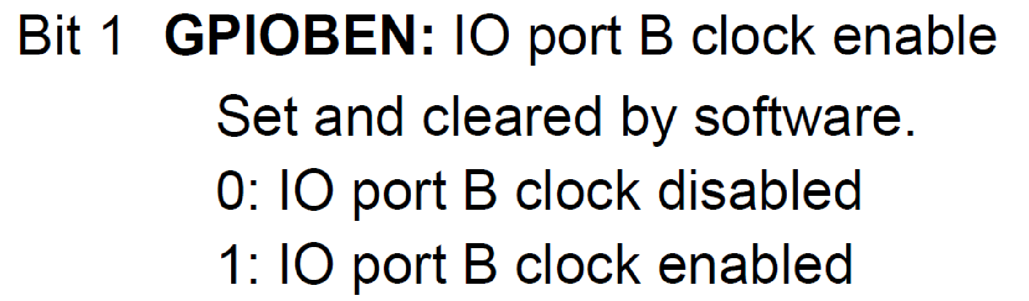
Enable Clock
AHB2 peripheral clock enable register (RCC_AHB2ENR)
SYSCLK
Clock for Port B
1
GPIOEN
AND Gate
#define RCC_AHB2ENR_GPIOBEN ((uint32_t)0x00000002U)
RCC->AHB2ENR |= RCC_AHB2ENR_GPIOBEN;
Notes:
{{Pause=2}} To improve energy-efficiency, the clock of most peripherals, is turned off. As presented previously, the red LED is connected to the pin 2 of port B. {{Pause=1}} First of all, we need to enable the clock of G P I O Port B. The clock can be turned on or off by configuring the reset and clock control module (RCC). Specifically, the clock of port B is controlled by the AHB2, peripheral clock enable register (A H B 2 E N R). We need to set bit 1, that is, G P I O B Enable Bit, of this register to 1. When G P I O B Enable bit is 1, the clock signal can pass through this logic {{Pause=0.1}} AND gate to drive the port B. On the other hand, if G P I O B Enable it is zero, the output of the logic {{Pause=0.1}} AND gate is always zero. Accordingly, the port B has no clock input.
{{Pause=1}} Software can set G P I O B Enable bit to 1 by using bitwise OR. In order to make the code more readable, we use this macro to define this constant. In fact, this macro has already been defined in the device header file.

Slide 16
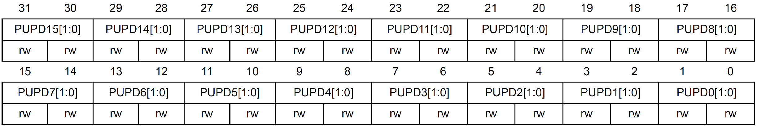
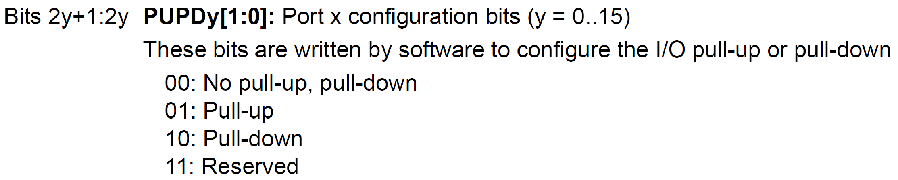
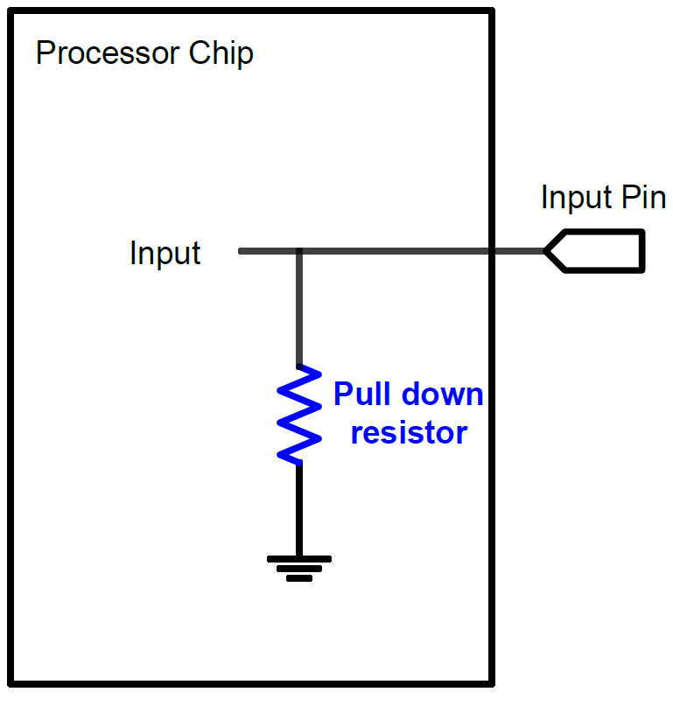
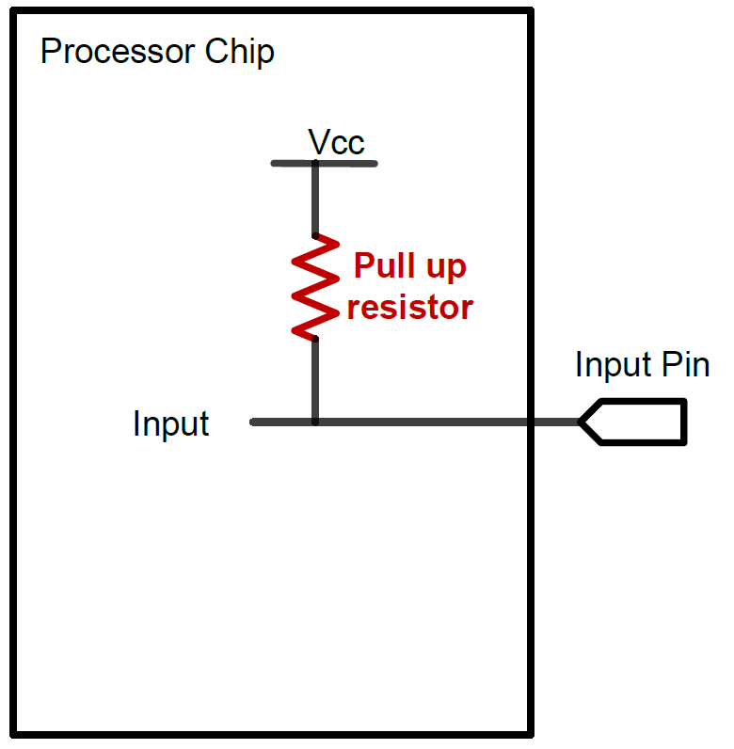
GPIO Pull-up/Pull-down Register (PUPDR)
16 pins per port, 2 bits per pin
Pin 2
Pin 1
Pin 0
// No pull-up, pull-down
GPIOA->PUPDR &= ~3UL;
Pull-Down
Pull-Up
Notes:
{{Pause=2}} When a G P I O pin is used for digital input, the default state of a pin can be high voltage, low voltage, or high impedance. The high impedance state is also called floating or tri-stated. Pull-up and pull-down are used to ensure the input pin has a valid input, either logic 1 or logic 0, when the external circuit does not drive the pin. {{Pause=1}} When a pin is configured as pull-down, the pin is then internally connected to the ground via a resistor. Similarly, when software configures a pin as pull-up, the pin is internally connected to the power supply via a resistor. When a pin is neither pulled up nor pulled down internally, then the pin has high impedance. {{Pause=1}} Note that the internal pull-up and pull-down resistors have large impedance, typically large than 10K ohms. When external circuit, connected to a G P I O pin, has a fair amount of capacitance, the process of, pulling the pin voltage to the level of logic high or logic low, takes a long time. This is because the impedance of, the internal pull-up and pull-down resistors, is too large. To meet the speed requirements, external pull-up or pull-down with small resistors, are often needed.
{{Pause=1}} Here is the C code that sets pin 0 as no pull-up, no pull-down. It clears bit 1 and bit 0 of the P U P D R register by bitwise AND. Note that that pin 0 has already been pulled down externally. Therefore, we do not have to pull it down internally.

Slide 17
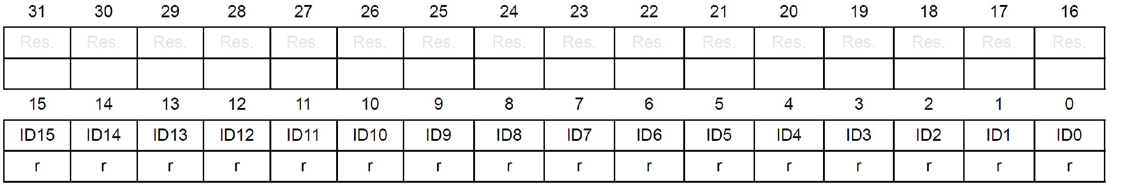
GPIO Input Data Register (IDR)
16 bits reserved, 16 data bits (1 bit per pin)
// Demo of reading pin 7
uint32_t mask = 1UL<<7;
uint32_t input = (GPIOA->IDR & mask) == mask;
or
uint32_t input = (GPIOA->IDR & mask) >> 7;
Notes:
{{Pause=2}} The digital input is sampled every APB cycle. If the input is high, then the corresponding bit, in the input data register (IDR), is set. We can use a mask to read the read the individual bit of the input data register. as shown in this C code. For example, in order to read the input on pin 7, we first define a mask. Then, we use bit-wise operation AND. We compare the bit-wise result with the mask. If they are the same, the input on pin 7 is 1. Otherwise, the input is 0.

Slide 18
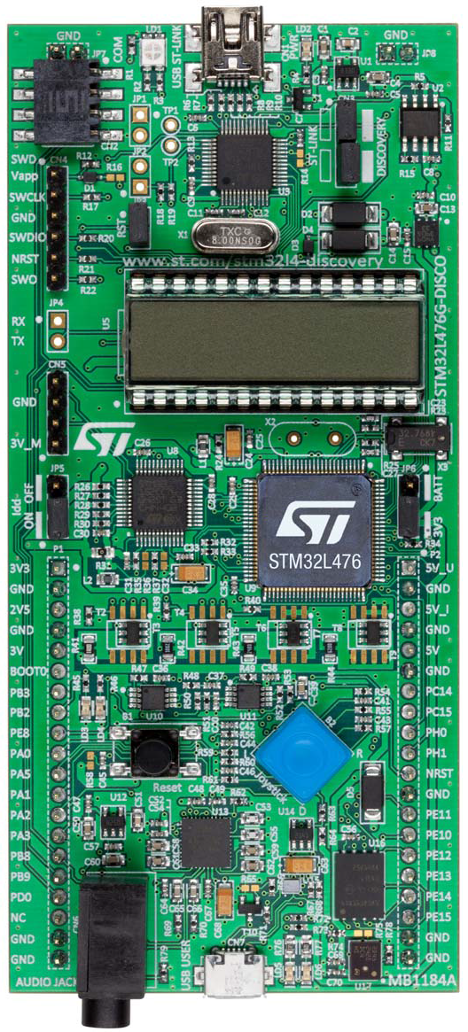
Joystick
STM32L4
STM32L4 Discovery Kit
Up
Left
Center
Right
Joystick with 4-direction control and selector
Down
Notes:
{{Pause=2}} The STM32L4 discovery kit has a four-direction joystick. The user may push in one of four directions at a time : up, down, left, and right. The user may also press the center of the joystick. The center is often used as a selector.

Slide 19
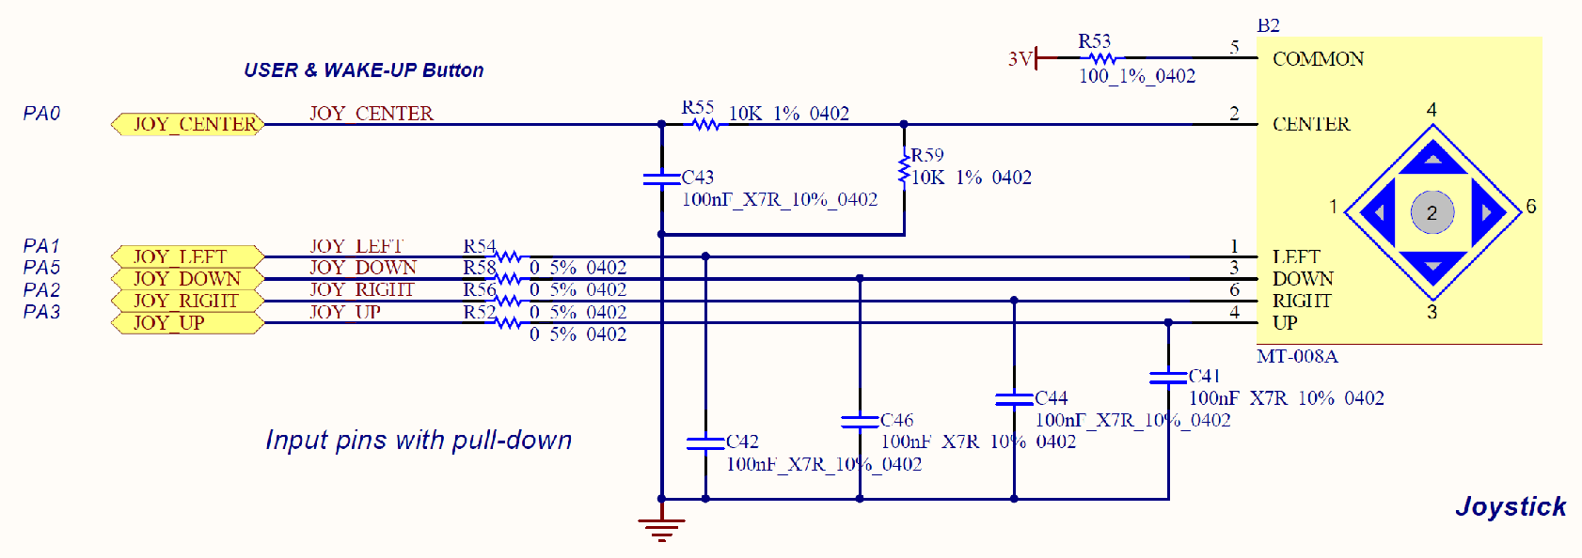
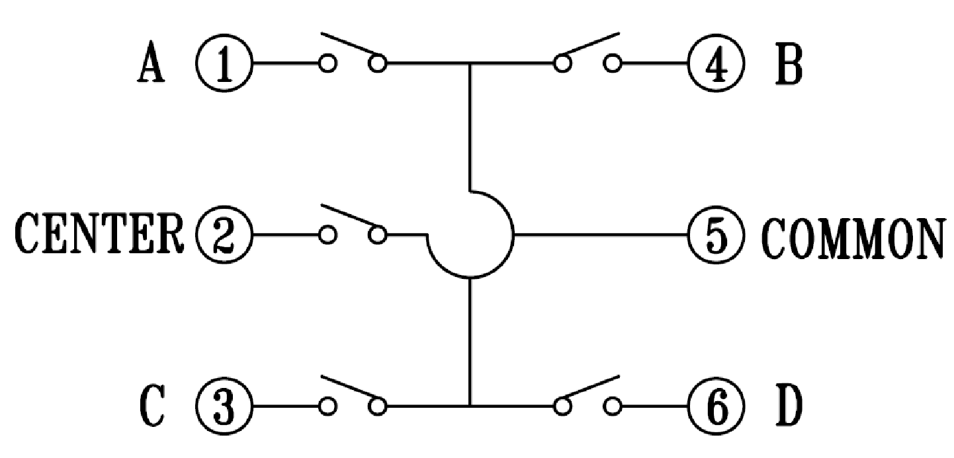
Joystick
PA0
+3V
Internal diagram of joystick
Notes:
{{Pause=2}} Here is the schematic diagram, which shows the connections between the processor pins and the joystick. G P I O pins PA 0, PA 1, PA 5, PA 2, PA 3 are connected to the center, left, down, right, and up pin of the joystick, respectively. Each pin is connected to the ground, via a capacitor. The purpose of these capacitors is to perform hardware debouncing. When pressed, the switch within the joystick may bounce back and forth a few times before settling down. The bounces usually settle within 20 milliseconds. A capacitor can filter out any quick changes in a signal. Therefore, the capacitor can remove the bounces or glitches associated with switch transitions.
{{Pause=1}} Here is the internal diagram of the joystick. It has five switches. The common terminal is connected to the positive 3 volt. In this lecture, we will write a software program, to detect whether the center of the joystick is pressed. When the user presses the center of the joystick, this center switch is then closed. As result, pin PA 0 is then connected to the 3 volt. Note that, the joystick center terminal, is pulled down to ground, via a 10K resistor. Therefore, the default voltage on the joystick center terminal is zero. However, the other four joystick terminals are not pulled down.

Slide 20
Read Input of Pin PA.0
uint32_t input;
RCC->AHB2ENR |= RCC_AHB2ENR_GPIOAEN; // Enable clock of Port A
GPIOA->MODER &= ~3UL; // Set PA.0 as digital input
GPIOA->PUPDR &= ~2UL; // pull-down
// Read pin 0
input = (GPIOA->IDR & 1UL);
if (input == 0) {
// Center of joystick is not pressed
...
} else {
// Center of joystick is pressed
...
}
Notes:
{{Pause=2}} This slide summarizes the software code, which read the input of the center switch of the joystick. Note that the center terminal of the joystick is connected to pin 0 of port A. The software involves four steps. First, we turn on the clock to enable port A. Then, we set the mode of pin 0 as digital input. Next, we select no pull-up and no pull-down for pin 0. Finally, we read bit 0 by using bit-wise AND. If the bit-wise result is zero, then the center of the joystick is not pressed. Otherwise, it is pressed.

Slide 21
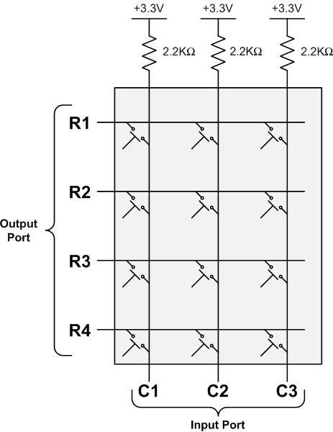
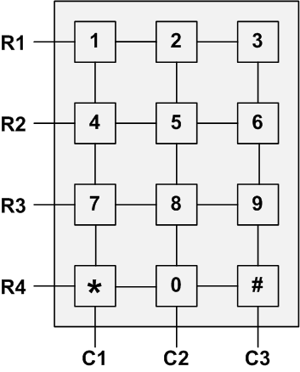
Keypad Scan

Slide 22
Keypad Scan
0
Step 1: Set Output
R1,R2,R3,R4 = 0000
Step 2: Read Input
C1,C2,C3 = 111
0
0
⟹ No key pressed
0
1
1
1

Slide 23
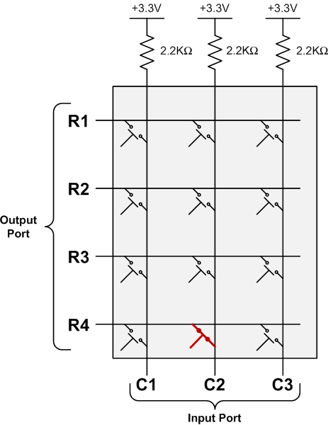
Keypad Scan
Key “0” is pressed

Slide 24
Keypad Scan
0
Step 1: Set Output
R1,R2,R3,R4 = 0000
Step 2: Read Input
C1,C2,C3 = 101
⟹ Some key in 2nd column is pressed down
0
0
0
1
0
1

Slide 25
Keypad Scan
Scan 1st row
0
Step 1: Set Output
R1,R2,R3,R4 = 0000
Step 2: Read Input
C1,C2,C3 = 101
Step 3a: Scan 1st row
R1,R2,R3,R4 = 0111
C1,C2,C3 = 111
⟹ No key in 1st row
is pressed down
1
1
1
1
1
1

Slide 26
Keypad Scan
Scan 2nd row
1
Step 1: Set Output
R1,R2,R3,R4 = 0000
Step 2: Read Input
C1,C2,C3 = 101
Step 3b: Scan 2nd row
R1,R2,R3,R4 = 1011
C1,C2,C3 = 111
⟹ No key in 2nd row
is pressed down
0
1
1
1
1
1

Slide 27
Keypad Scan
Scan 3rd row
1
Step 1: Set Output
R1,R2,R3,R4 = 0000
Step 2: Read Input
C1,C2,C3 = 101
Step 3c: Scan 3rd row
R1,R2,R3,R4 = 1101
C1,C2,C3 = 111
⟹ No key in 3rd row
is pressed down
1
0
1
1
1
1

Slide 28
Keypad Scan
Scan 4th row
1
Step 1: Set Output
R1,R2,R3,R4 = 0000
Step 2: Read Input
C1,C2,C3 = 101
Step 3d: Scan 4th row
R1,R2,R3,R4 = 1110
C1,C2,C3 = 101
⟹ key in 4th row
is pressed down
1
1
0
1
0
1

Slide 29
Keypad Scan
1
⟹ Key pressed is located at the second column and the fourth row.
1
1
0
1
0
1

Slide 30
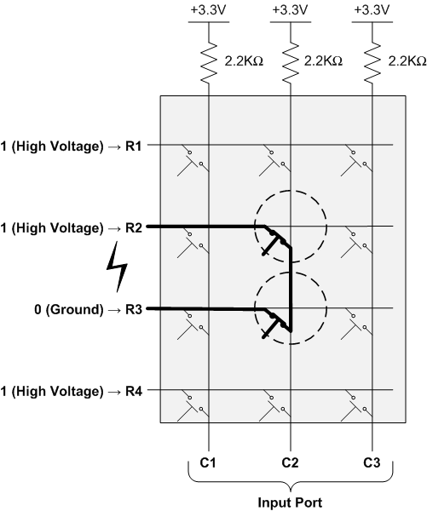
Keypad Scan

Slide 31
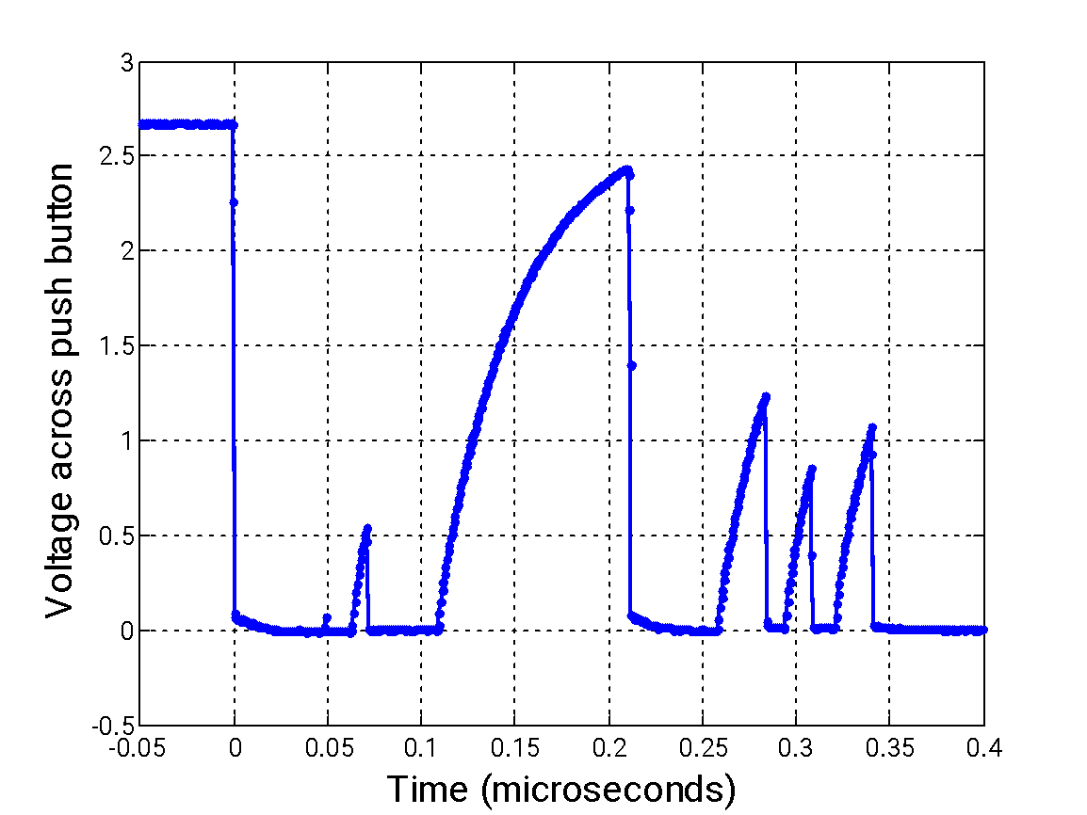
I/O Debouncing
Example signal when a button is pressed

